Slide 1
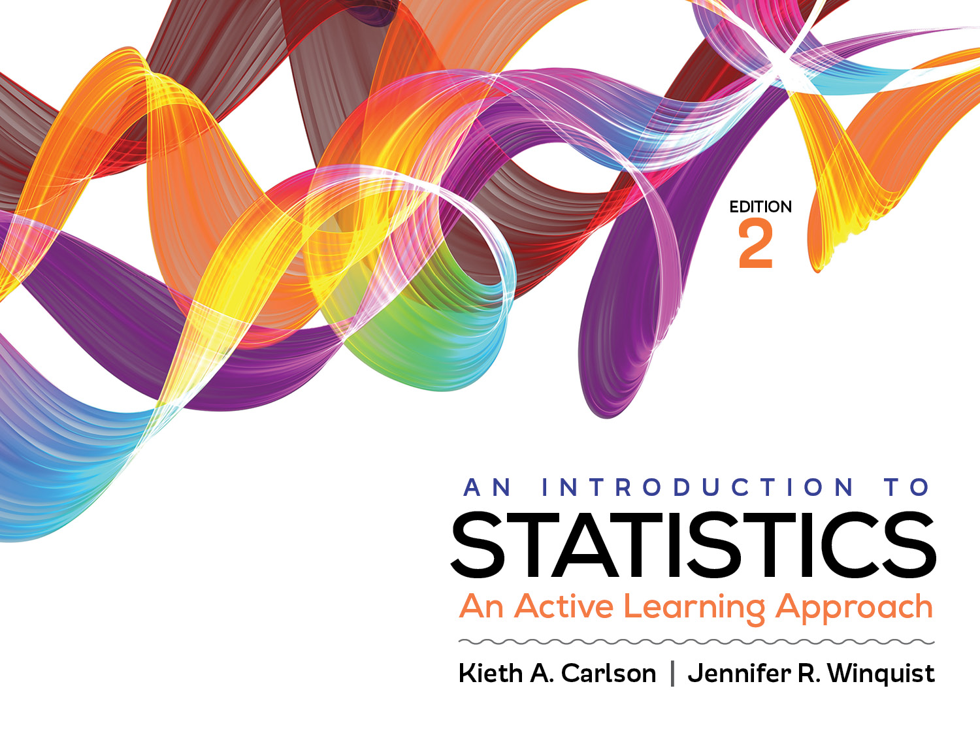
Introduction to Activity 12.4
One-Way and Two-Way ANOVA Review

Slide 2
Activity 12.4 will require you to:
Describe the difference between one-way and two-way ANOVAs
Summarize the SPSS results from each type of ANOVA

Slide 3
Comparing 1-way and 2-way ANOVAs
Which type of ANOVA can test for an interaction hypothesis? Why can’t the other test an interaction hypothesis?
How many IVs does each have?
How many DVs does each have?
How many significance tests does each produce? Name them.
Notes:
2-way ANOVAs test for interactions two IVs; 1-way ANOVAs can’t because they only have 1 IV
See above
Both have only 1 DV
1-way only produces 1 test. It is sometimes called an omnibus test. 2 main effects and an interaction

